Slide 1
Chapter 2 Communication and Perception Keimyung University
2.1 Perception Process
LEARNING OBJECTIVES
1. | Defining perception
2. | Salience
3. | Organizing Perceptual Information
4. | Schemata

Slide 2
Chapter 2 Communication and Perception Keimyung University
2.1 Perception Process
Defining perception
Perception is the process of selecting, organizing , and interpreting information.

Slide 3
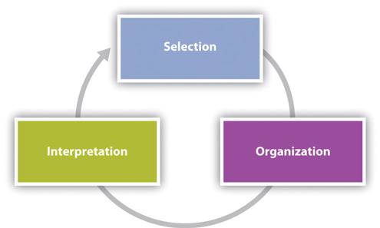

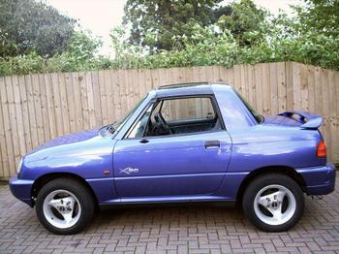
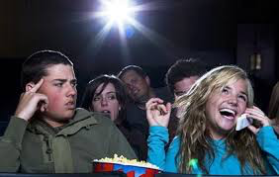
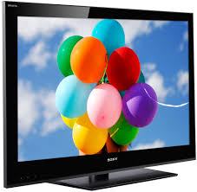

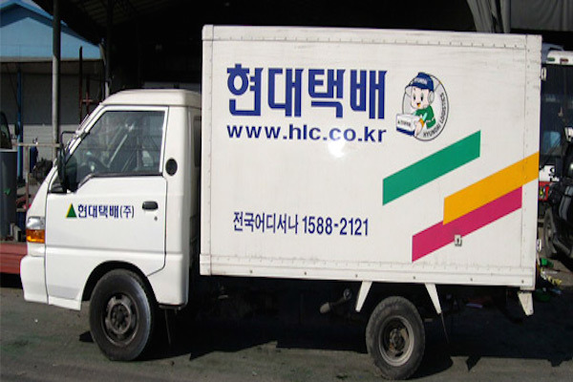
Chapter 2 Communication and Perception Keimyung University
2.1 Perception Process
Salient
Visual
Aural
Needs and Interests
Expectations

Slide 4

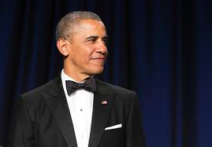
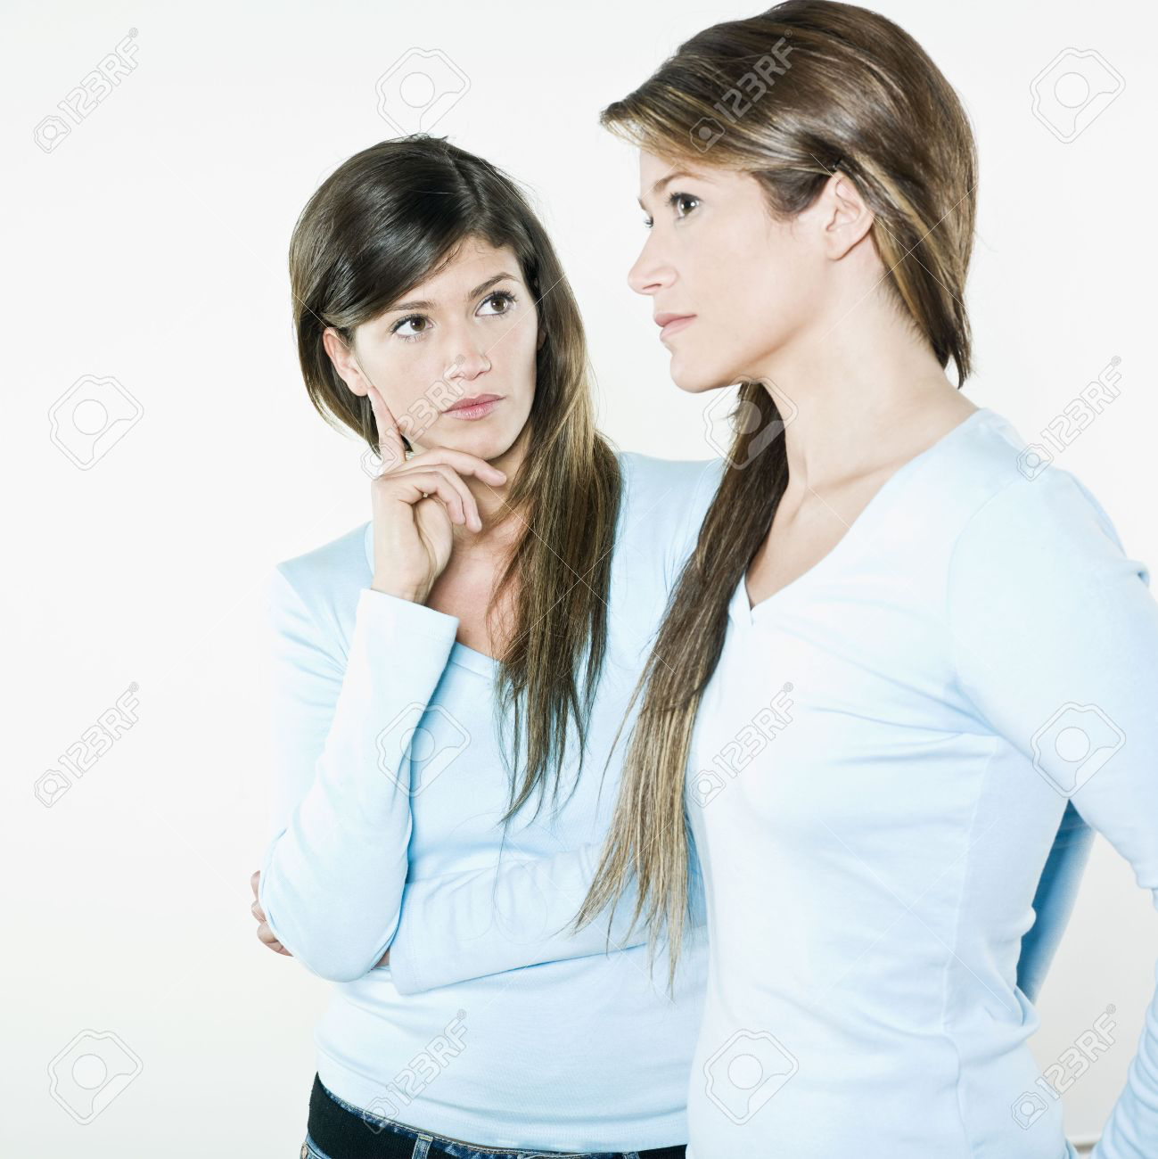

Chapter 2 Communication and Perception Keimyung University
2.1 Perception Process
Proximity
Difference
Similarity
Punctuality

Slide 5
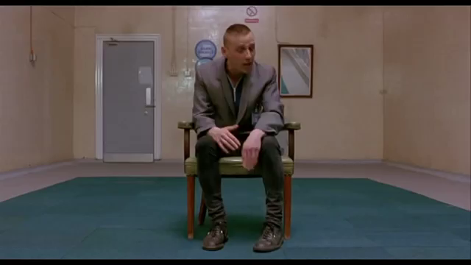

Chapter 2 Communication and Perception Keimyung University
2.1 Perception Process
Schemata

Slide 6
Chapter 2 Communication and Perception Keimyung University
2.1 Perception Process
Exercises
1. | Take a moment to look around wherever you are right now. Take in the perceptual field around you. What is salient for you in this moment and why? Explain the degree of salience using the three reasons for salience discussed in this section.
2. | As we organize information (sensory information, objects, and people) we simplify and categorize information into patterns. Identify some cases in which this aspect of the perception process is beneficial. Identify some cases in which it could be harmful or negative.
3. | Getting integrated: Think about some of the schemata you have that help you make sense of the world around you. For each of the following contexts—academic, professional, personal, and civic—identify a schema that you commonly rely on or think you will rely on. For each schema you identified note a few ways that it has already been challenged or may be challenged in the future.

Slide 7
Chapter 2 Communication and Perception Keimyung University
2.2 Perceiving Others
LEARNING OBJECTIVES
1. | Internal and External Attributions
2. | Perceptual Errors – Fundamental Attribution Error & Self-Serving Bias
3. | Primacy and Recency
4. | Physical and Environmental
5. | Horn and Halo Effects
6. | Culture and Personality

Slide 8
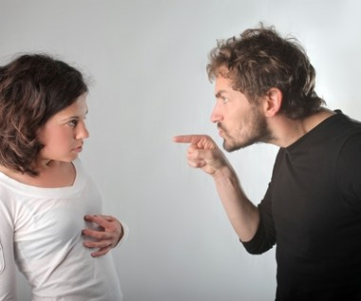
Chapter 2 Communication and Perception Keimyung University
2.2 Perceiving Others
Why..?
Attribution
Internal
External

Slide 9
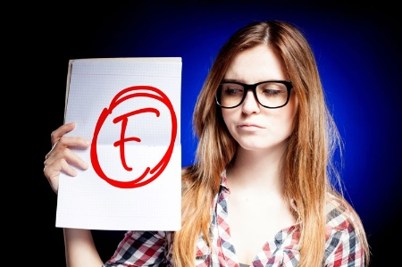

Chapter 2 Communication and Perception Keimyung University
2.2 Perceiving Others
Why..?
Attribution
Perceptual Errors
Fundamental
Self-serving Bias

Slide 10
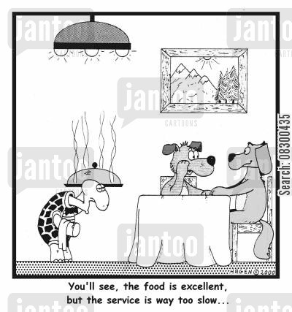

Chapter 2 Communication and Perception Keimyung University
2.2 Perceiving Others
Impressions and Interpretation
First and Last Impressions
Primacy Effect
Recency Effect

Slide 11
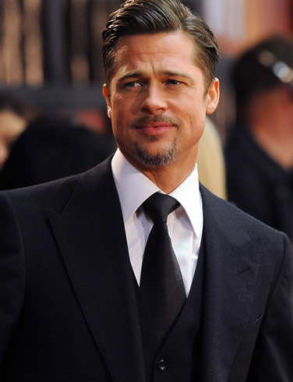
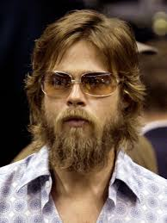

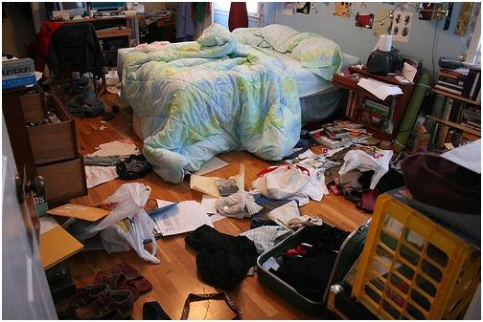
Chapter 2 Communication and Perception Keimyung University
2.2 Perceiving Others
Influences on Perception
Physical
Environmental

Slide 12
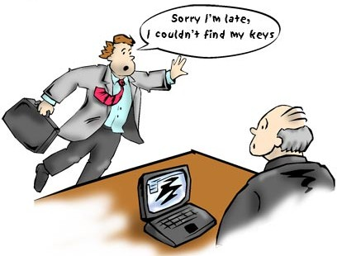

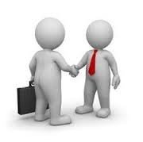
Chapter 2 Communication and Perception Keimyung University
2.2 Perceiving Others
Halo
Horn
Employer (and the Teacher’s friend)
Teacher
Student

Slide 13
Chapter 2 Communication and Perception Keimyung University
2.2 Perceiving Others
Culture, Personality, and Perception
Culture
Personality
Assumed Similarity
Identities
Extraversion
Sight
Agreeableness
Sound
Conscientiousness
Touch
Taste
Neuroticism
Smell
Openness
Variation

Slide 14
Chapter 2 Communication and Perception Keimyung University
2.2 Perceiving Others
Exercises
1. | Think of a recent conflict and how you explained the behavior that caused the conflict and subsequently formed impressions about the other person based on your perceptions. Briefly describe the conflict situation and then identify internal and external attributions for your behavior and the behavior of the other person. Is there any evidence of the fundamental attribution error or self-serving bias in this conflict encounter? If so, what?
2. | Describe a situation in which you believe the primacy and/or recency effect influenced your perceptions of a person or event.
3. | Has your perception of something ever changed because of exposure to cultural difference? For example, have you grown to like a kind of food, music, clothing, or other custom that you earlier perceived unfavorably?

Slide 15
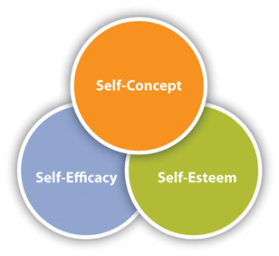
Chapter 2 Communication and Perception Keimyung University
2.3 Perceiving and Presenting Self
Overall idea of who you are
Judgments people make about their ability to perform a task in a specific context
Judgments and evaluations about who we are

Slide 16
Chapter 2 Communication and Perception Keimyung University
2.3 Perceiving and Presenting Self
Self-Discrepancy Theory
Actual Self
The attributes you or someone else
believes you actually possess
Ideal Self
The attributes you or someone else
would like you to possess
Ought Self
The attributes you or someone else
believes you should possess

Slide 17
Chapter 2 Communication and Perception Keimyung University
2.3 Perceiving and Presenting Self
Self-Discrepancy Theory
Problems:
Actual Self vs Own Ideal Self
Actual Self vs Other’s Ideal Self
Actual Self vs Own Ought Self
Actual Self vs Other’s Ought Self

Slide 18
Chapter 2 Communication and Perception Keimyung University
2.3 Perceiving and Presenting Self
Self-Presentation
The process of strategically concealing or revealing personal information in order to influence others’ perceptions.
Prosocial self-presentation
Self-serving self-presentation

Slide 19
Chapter 2 Communication and Perception Keimyung University
2.3 Perceiving and Presenting Self
Self-Presentation Online
Social Media
Digital Trails
What impressions do you want people to form of you based on the information they can see on your Facebook page?
Have you ever used social media or the Internet to do “research” on a person? What things would you find favorable and unfavorable?
Do you have any guidelines you follow regarding what information about yourself you will put online or not? If so, what are they? If not, why?

Slide 20
Chapter 2 Communication and Perception Keimyung University
2.4 Improving Perception
Improving Self-Perception
- Avoiding reliance on rigid schemata
- Thinking critically about socializing institutions
- Intervening in self-fulfilling prophecies
- Finding supportive interpersonal networks
Improving your Perceptions of Others
Developing empathetic listening skills
Becoming aware of stereotypes and prejudice
Engaging in self-reflection.

